Slide 1
Department of Information Technology
(NBA Accrediated)
Project Title: Smart Student Mentoring Management System
Roll No. | PRN No. | Name of Student
102 | 0124UITM1102 | Pawade Vishwajeet
103 | 0124UITM1103 | Sonawane Samartha
104 | 0124UITM1104 | Rothe Pavan
105 | 0124UITF1105 | Bhagwat Ganesha
Guided by : Dr. S. N. Gunjal

Slide 2
INTRODUCTION
Smart Student Mentoring Management System
In modern education, students require personalized guidance beyond classroom teaching.
Traditional mentoring methods are manual, inconsistent, and poorly tracked.
Lack of proper monitoring leads to poor academic performance and communication gaps.
Our system provides a digital mentoring platform to connect students, mentors, and administrators efficiently.
DEPARTMENT OF INFORMATION TECHNOLOGY, Sanjivani COE, Kopargaon

Slide 3
PROJECT DEFINITION & SCOPE
Definition: A software system designed to manage and automate student mentoring activities, including session scheduling, progress tracking, and feedback management.
Scope: Mentoring Session Scheduling.
Mentor-Student Mapping
Performance Tracking & Feedback.
DEPARTMENT OF INFORMATION TECHNOLOGY, Sanjivani COE, Kopargaon

Slide 4
FUNCTIONAL REQUIREMENT
FR1 :- User login (Student / Mentor / Admin)
FR2 :- Role-based access control
FR3 :- Student can request mentoring session
FR4 :- Mentor can accept/reject requests
FR5 :- Mentor can provide feedback
FR6 :- Student can view performance & feedback
FR7 :- Admin can manage users (add/update/delete)
FR8 :- Admin assigns mentors to students
FR9 :- System stores session and performance data
FR10 :- Generate reports
DEPARTMENT OF INFORMATION TECHNOLOGY, Sanjivani COE, Kopargaon

Slide 5
NON - FUNCTIONAL REQUIREMENT
Fast response (2–3 seconds)
Secure authentication & data protection
User-friendly interface
High reliability (24/7 availability)
Scalable for more users
Easy maintenance
Works on multiple devices (mobile/PC)
DEPARTMENT OF INFORMATION TECHNOLOGY, Sanjivani COE, Kopargaon

Slide 6
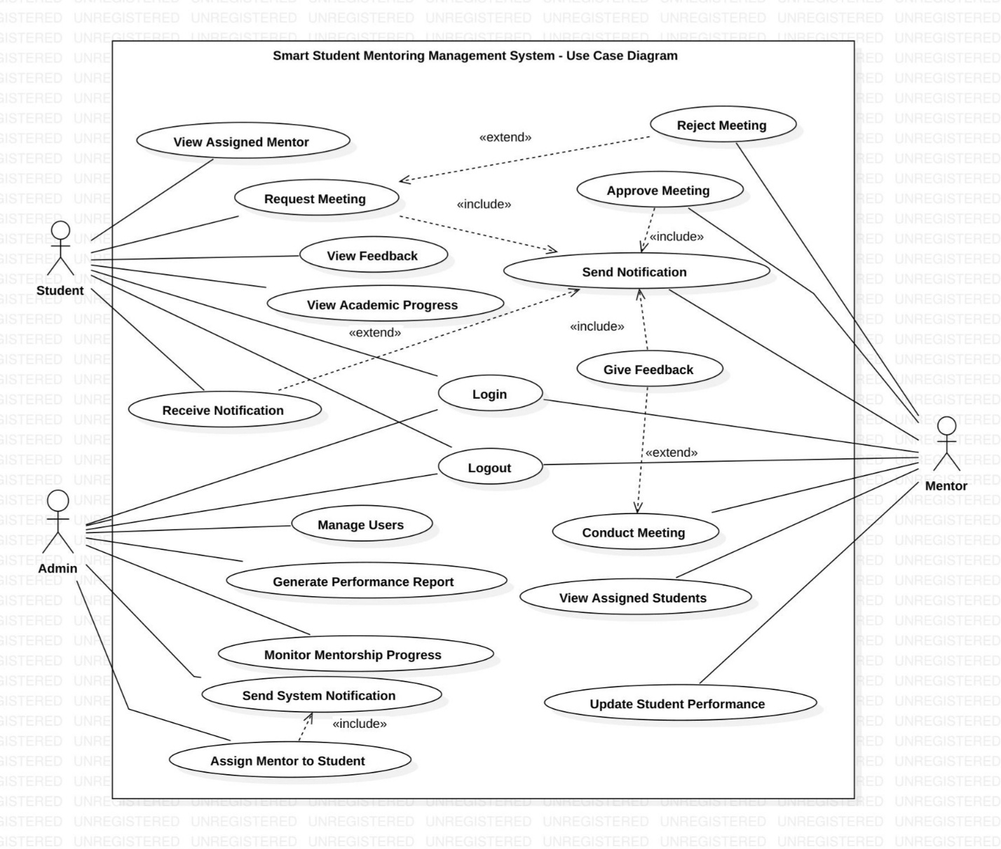
USECASE DIAGRAM
DEPARTMENT OF INFORMATION TECHNOLOGY, Sanjivani COE, Kopargaon

Slide 7
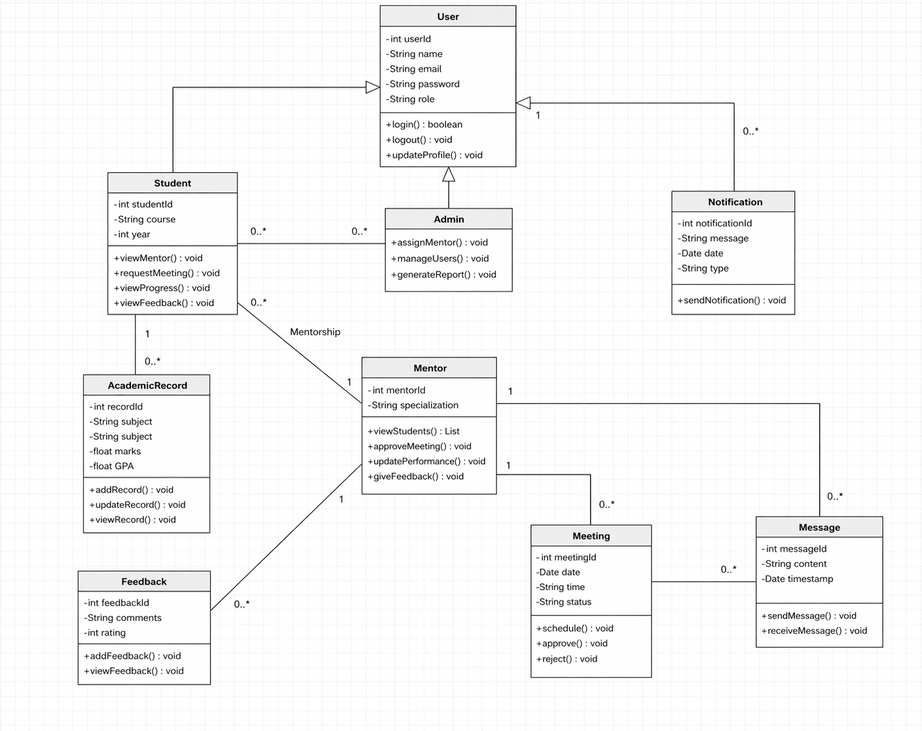
CLASS DIAGRAM
DEPARTMENT OF INFORMATION TECHNOLOGY, Sanjivani COE, Kopargaon

Slide 8
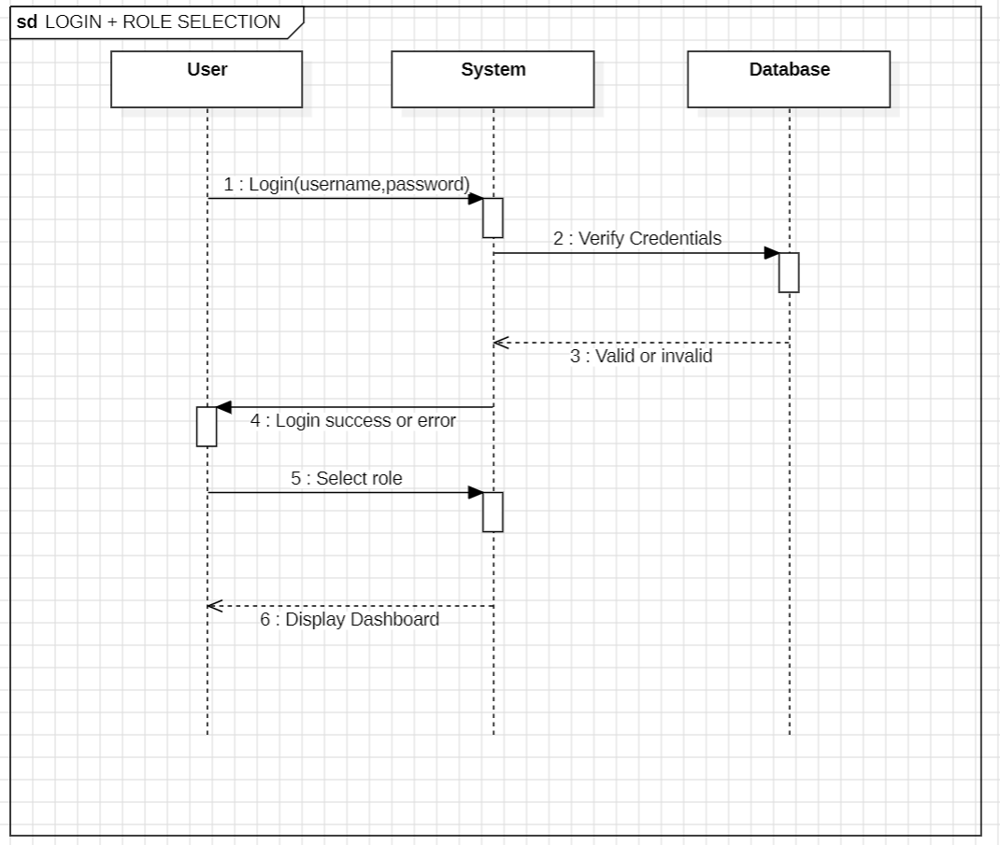
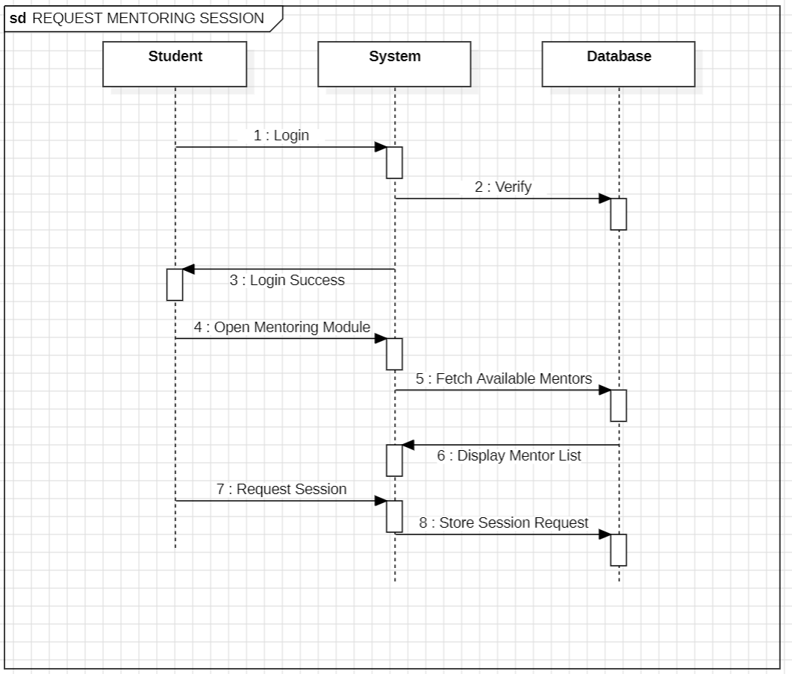
SEQUENCE DIAGRAM
DEPARTMENT OF INFORMATION TECHNOLOGY, Sanjivani COE, Kopargaon

Slide 9
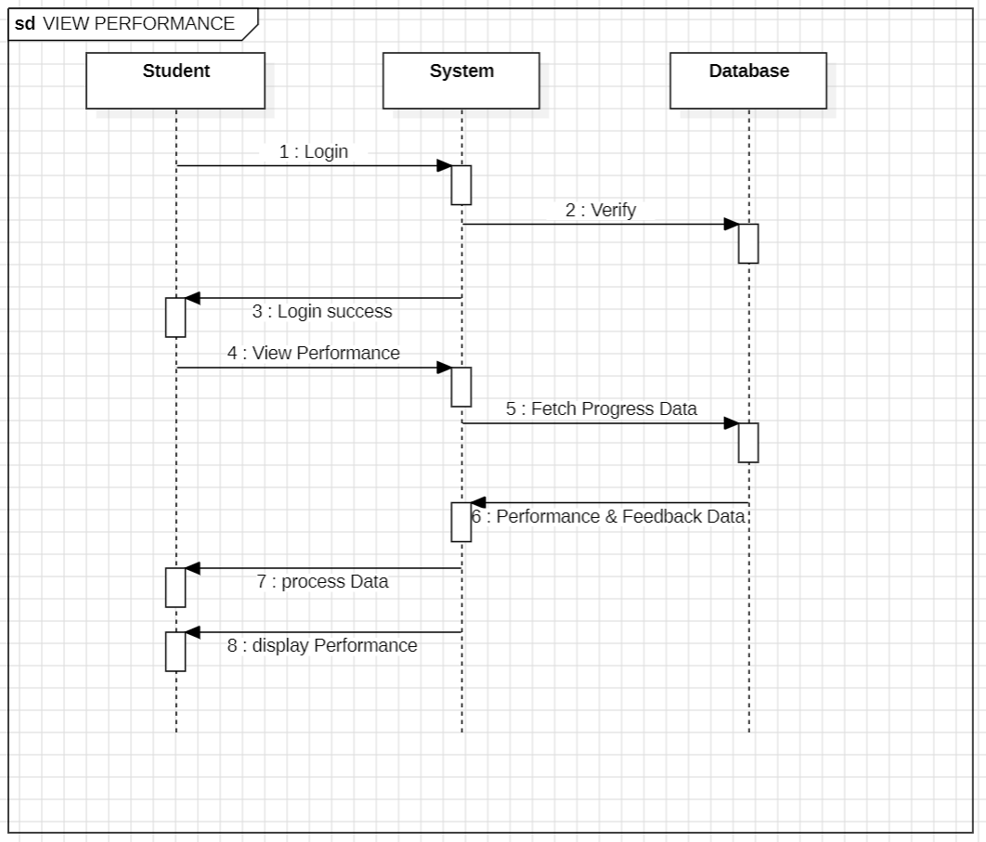
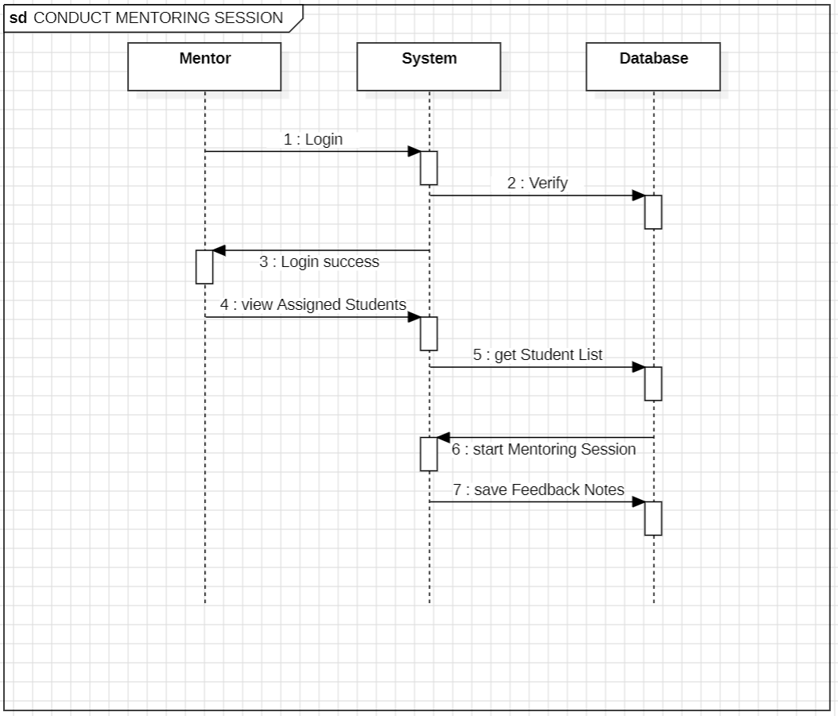
DEPARTMENT OF INFORMATION TECHNOLOGY, Sanjivani COE, Kopargaon

Slide 10
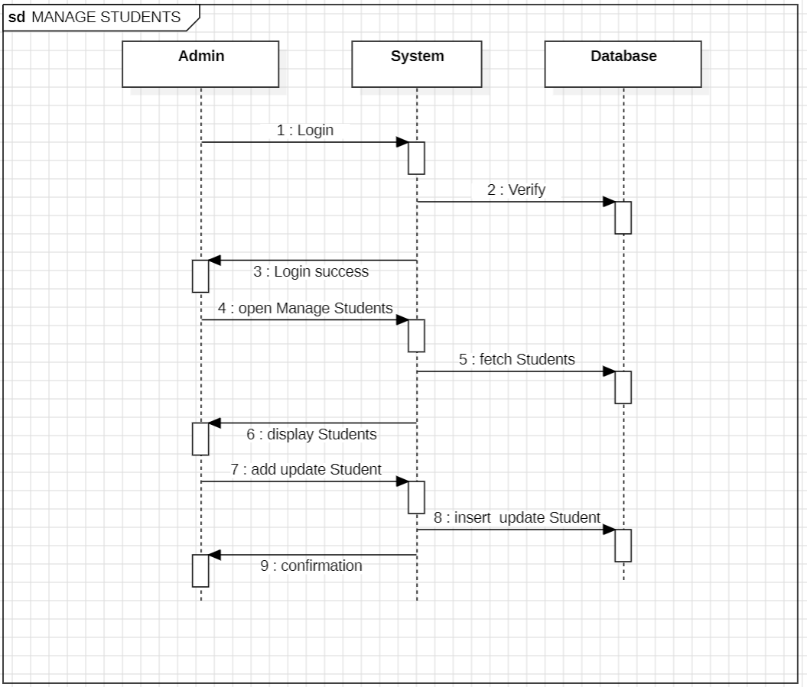
DEPARTMENT OF INFORMATION TECHNOLOGY, Sanjivani COE, Kopargaon

Slide 11
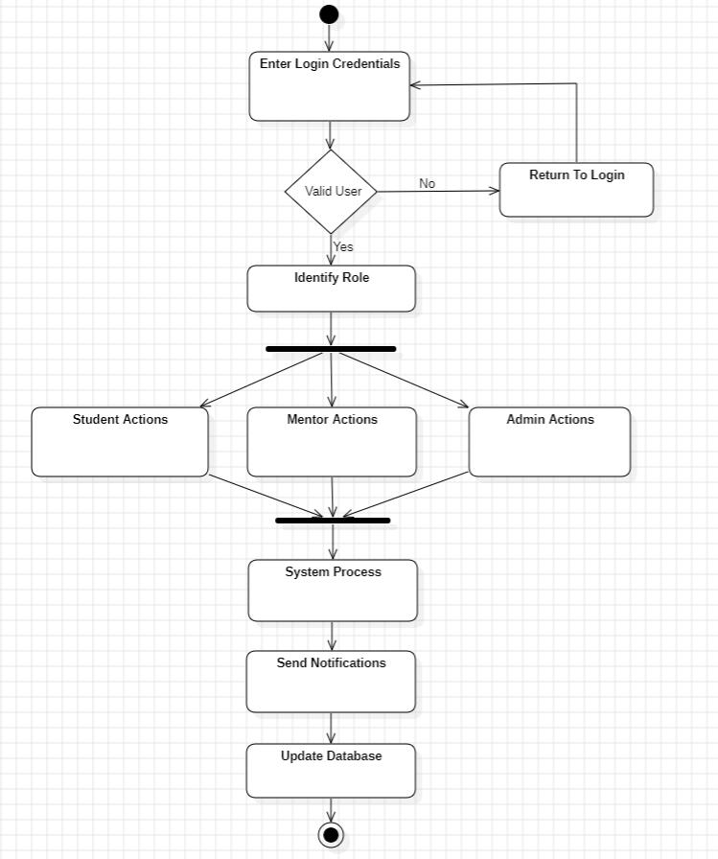
ACTIVITY DIAGRAM
DEPARTMENT OF INFORMATION TECHNOLOGY, Sanjivani COE, Kopargaon

Slide 12
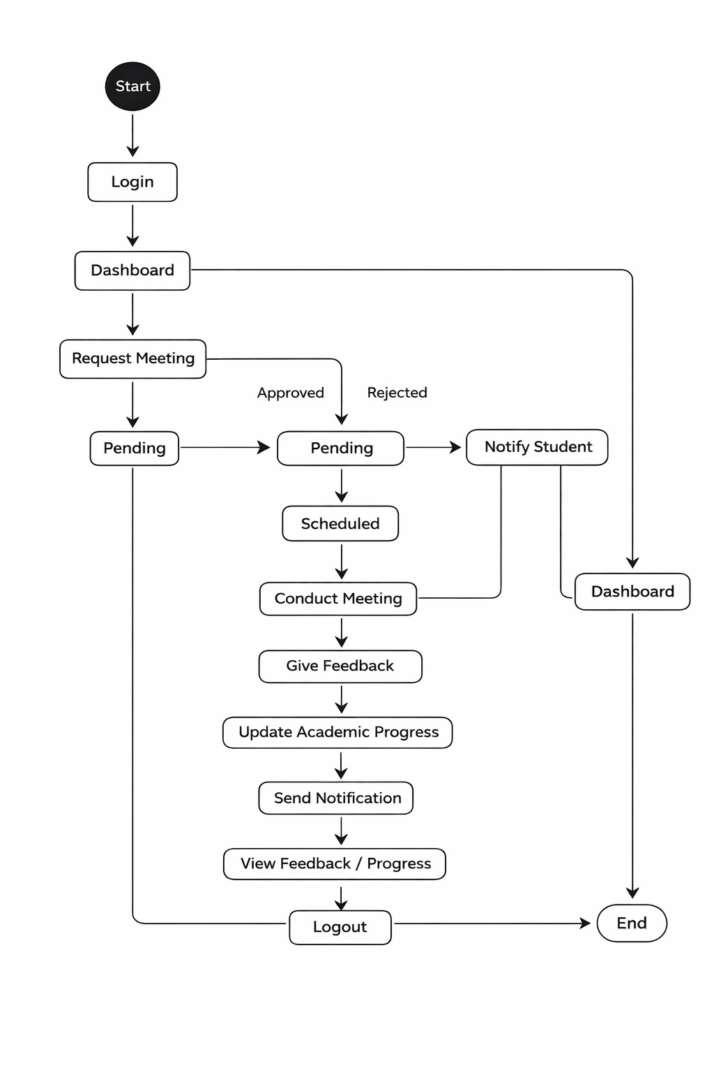
STATE CHART DIAGRAM
DEPARTMENT OF INFORMATION TECHNOLOGY, Sanjivani COE, Kopargaon

Slide 13
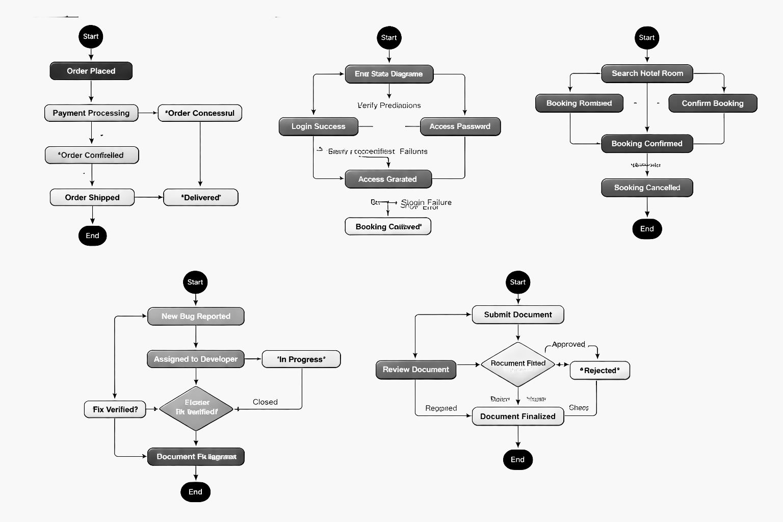
DEPARTMENT OF INFORMATION TECHNOLOGY, Sanjivani COE, Kopargaon

Slide 14
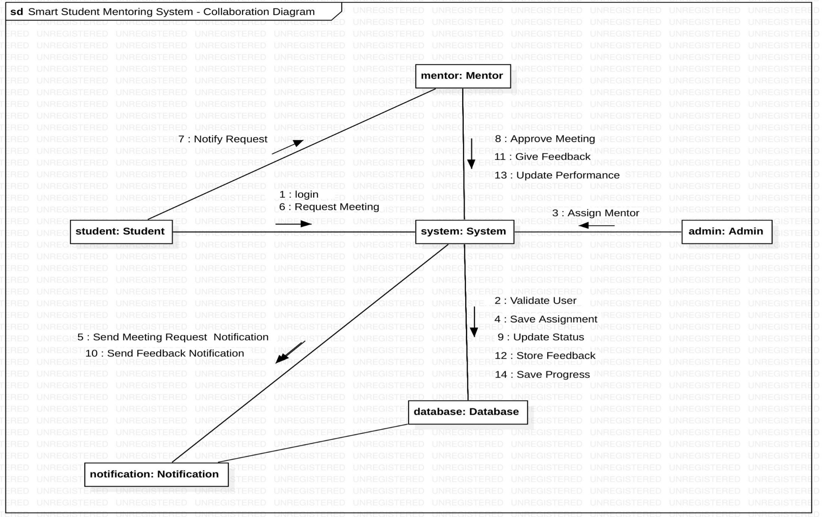
COLLABORATION DIAGRAM
DEPARTMENT OF INFORMATION TECHNOLOGY, Sanjivani COE, Kopargaon

Slide 15
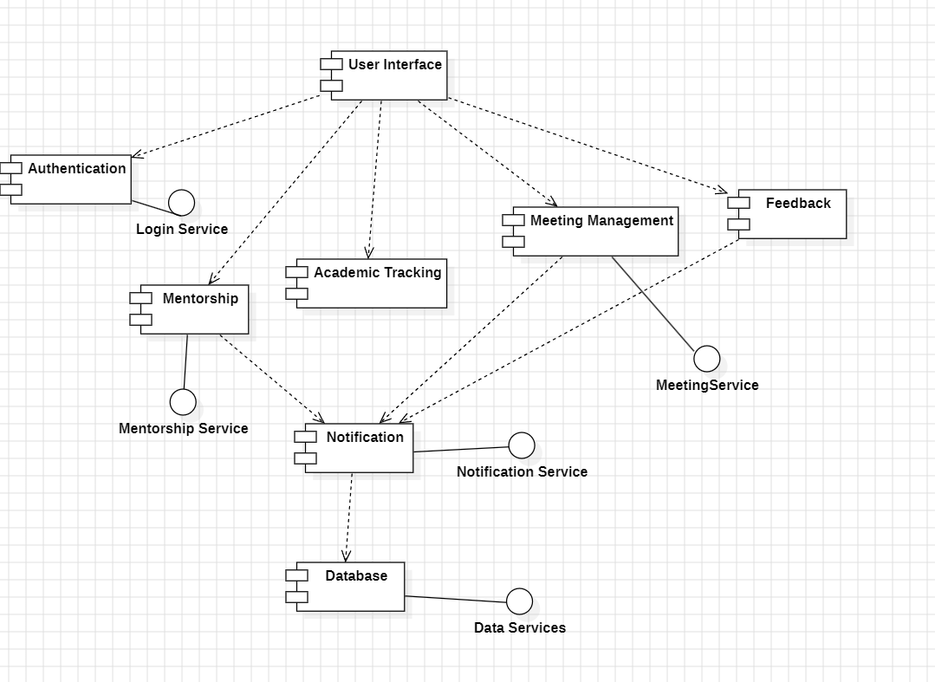
COMPONENT DIAGRAM
DEPARTMENT OF INFORMATION TECHNOLOGY, Sanjivani COE, Kopargaon

Slide 16
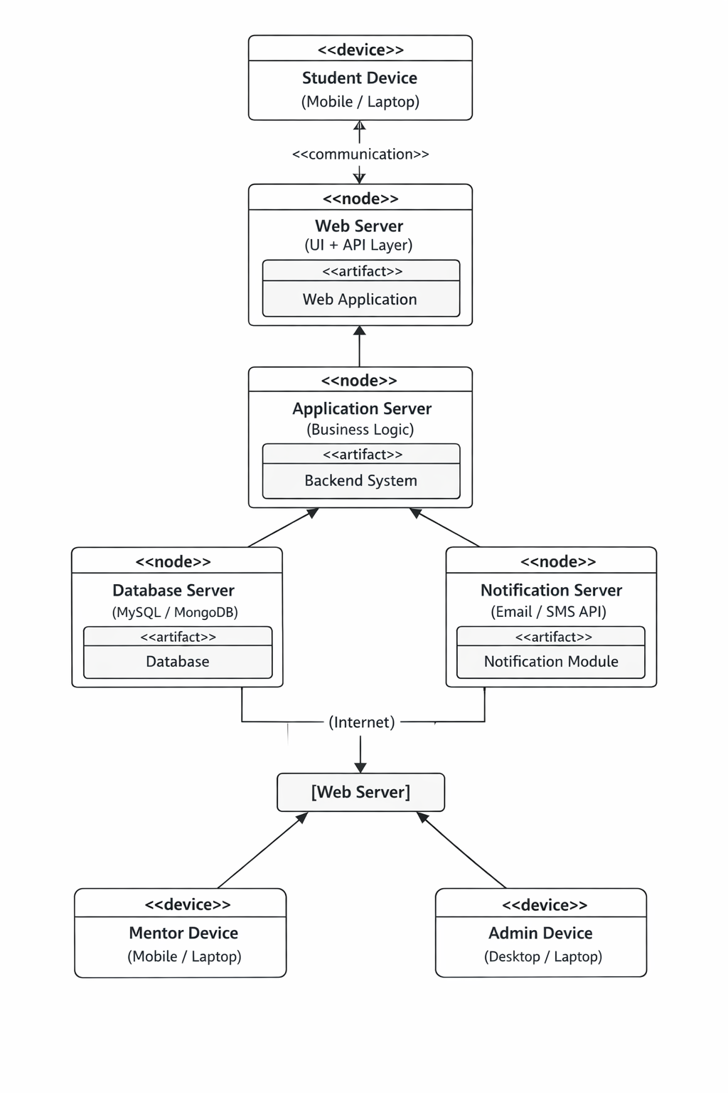
DEPLOYMENT DIAGRAM
DEPARTMENT OF INFORMATION TECHNOLOGY, Sanjivani COE, Kopargaon

Slide 17
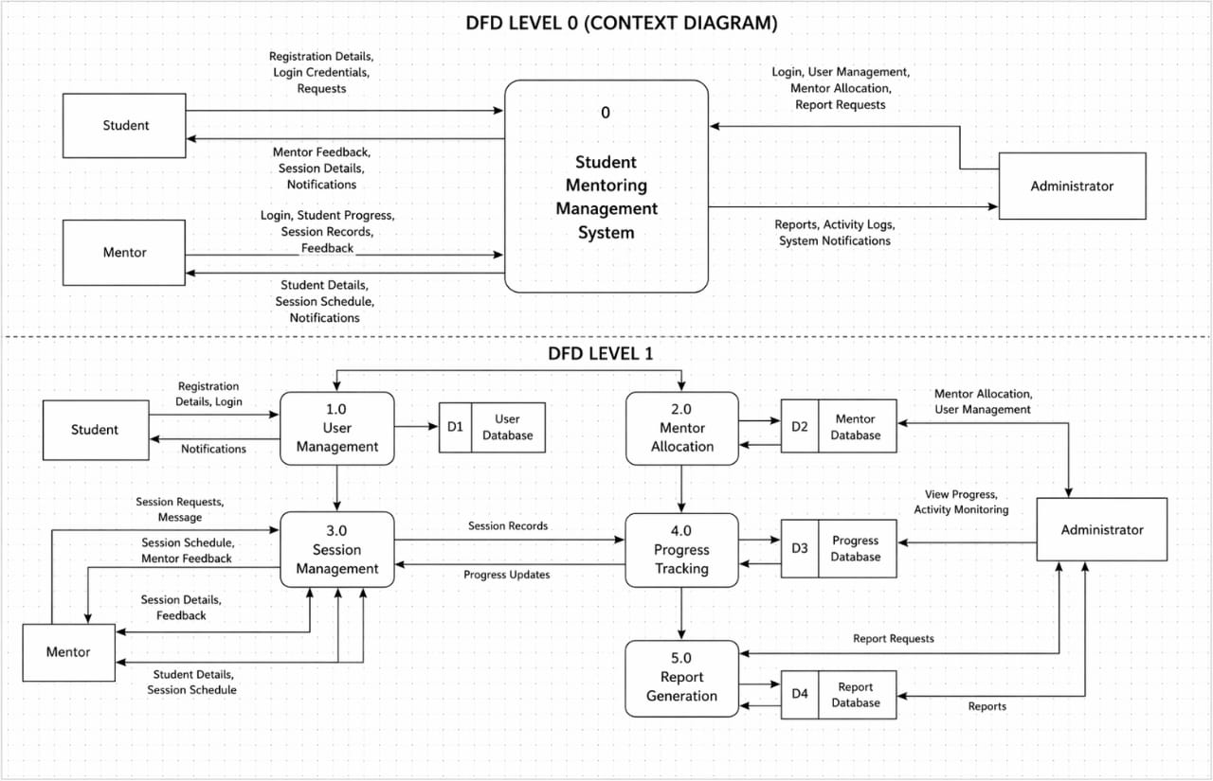
DATA FLOW DIAGRAM(DFD)
DEPARTMENT OF INFORMATION TECHNOLOGY, Sanjivani COE, Kopargaon

Slide 18
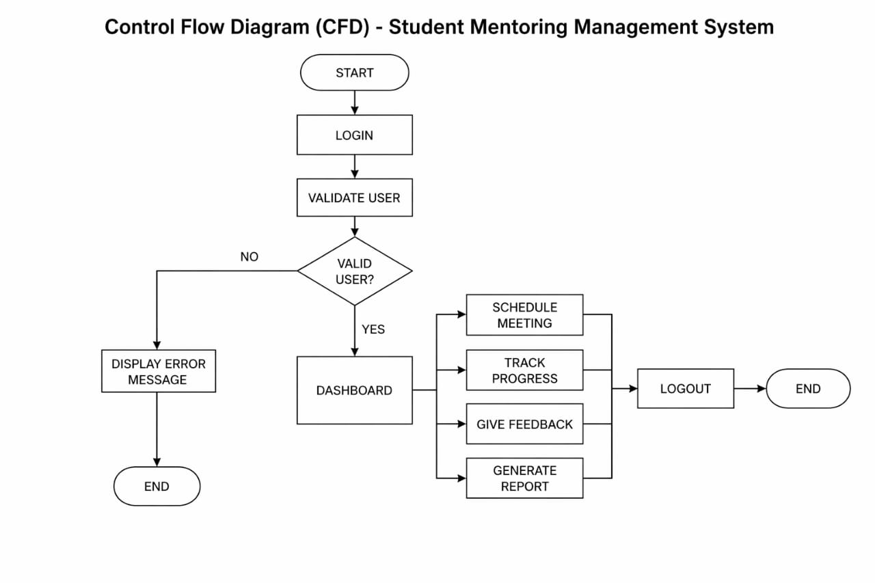
CONTROL FLOW DIAGRAM(CFD)
DEPARTMENT OF INFORMATION TECHNOLOGY, Sanjivani COE, Kopargaon

Slide 19
CONCLUSION
The Smart Student Mentoring Management System improves communication between students and mentors.
It provides structured mentoring, better tracking, and improved academic performance.
Reduces manual work and ensures efficient management of mentoring activities.
DEPARTMENT OF INFORMATION TECHNOLOGY, Sanjivani COE, Kopargaon

Slide 20
REFERENCES
IEEE Papers on Mentoring Systems.
UML Design Documentation.
Online Research Articles.
DEPARTMENT OF INFORMATION TECHNOLOGY, Sanjivani COE, Kopargaon

Slide 21
Thank You
DEPARTMENT OF INFORMATION TECHNOLOGY, Sanjivani COE, Kopargaon

